Slide 1



Crawling and Investigating our AIWebCrawler on the St. John's Website.
By: Elena Ajayi, Jomo Smith, Jordan Hayes, Joshua Souane, Omar Shajib, and Rosa DiLiberto

Slide 2
Agenda
Goal & Brief Overview of Project
Learning Outcomes
Key Features
AI Integration & Challenges
Summary/Next Steps

Slide 3

Goal & Brief Overview
Goal of the Project:
Create a Web-Crawler, with the help of LLMs, that can efficiently and thoroughly extract information from the St. John's University website
Success Metrics:
LLMs are used in requirement gathering and code generation
Crawler uses the chosen visiting strategy to crawl and extract data from all pages, static and dynamic, in St. John's domain
Data is stored systematically (key – value) and is free of irrelevant elements (JavaScript, HTML tags, and Menu items)
Data can be partically or fully retrieved based on user preference
Project Flow:
Launched project and assigned areas of focus
Used ChatGPT and Gemini to generate requirements based on project guidelines
Asked ChatGPT to generate Python code
Tested the codes and picked best performing
Went through several iteration of testing and fine-tuning to ensure success metrics are met
Wrote and compiled project documentation
3
Notes:
This project involved creating a web crawler with a focus on methodically navigating and harvesting information from various web pages, with a particular emphasis on St. John’s University's website. The development process began with defining the crawler's requirements, followed by generating Python and Selenium code with the assistance of ChatGPT. The team then integrated these codes into Python for testing and evaluation, seeking further modifications from ChatGPT as needed. The project report delves into several key areas, including the crawler's design implementation, the effectiveness of different crawling strategies, challenges encountered during development, the integration of artificial intelligence capabilities, and the impact of AI on enhancing programming skills.

Slide 4
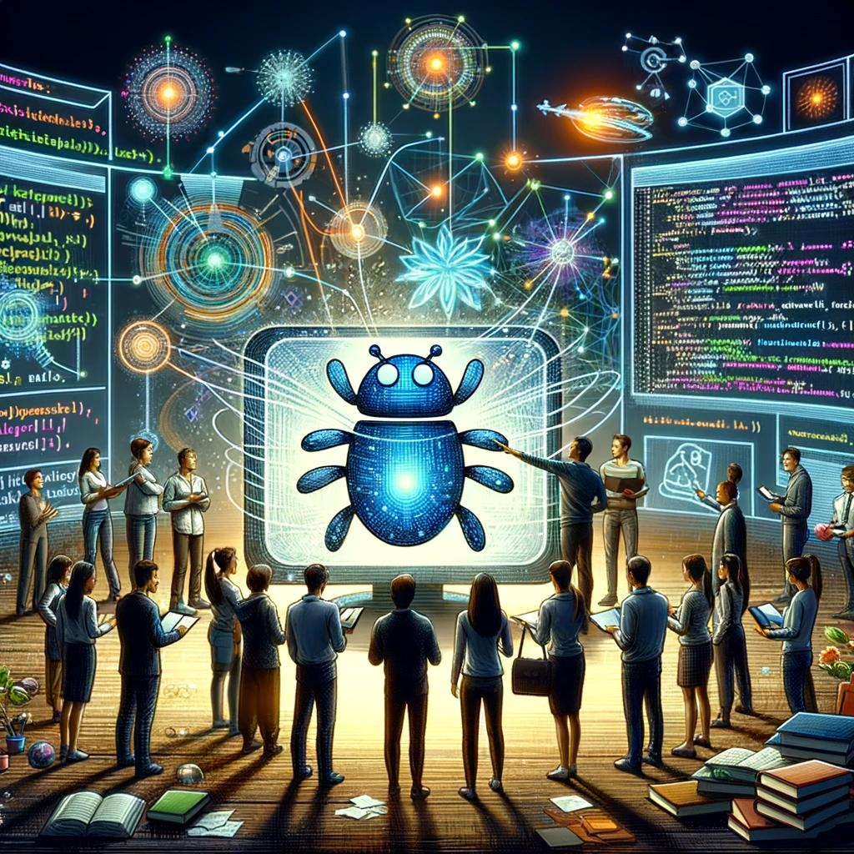
Learning Outcomes
After the WebCrawler was initiated, below are 8 learning outcomes that were attained.
Practical Application of AI in Software Development
Understanding Web Crawling Techniques
Code Integration and Testing
Problem-Solving and Debugging Skills
Ethical Considerations in Web Crawling
Insights into AI's Role in Programming
Enhancement of Programming Skills
Collaborative Learning and Innovation
Notes:
Practical Application of AI in Software Development: The team learned how to apply AI, particularly ChatGPT, to generate and refine code, showcasing AI's potential to aid in complex software development tasks.
Understanding Web Crawling Techniques: Through the project, team members gained an in-depth understanding of web crawling techniques, including the strategic exploration and data extraction from websites. This knowledge is crucial for projects that require systematic data collection from the internet.
Code Integration and Testing: The experience of integrating Python and Selenium code into a cohesive application taught the team about the challenges and nuances of bringing different pieces of code together to work seamlessly, as well as the importance of thorough testing.
Problem-Solving and Debugging Skills: Encountering and resolving issues during the crawler's development process enhanced the team's problem-solving, debugging, and prompt-engineering skills, critical competencies in software engineering.
Ethical Considerations in Web Crawling: The project underscored the importance of adhering to ethical guidelines when designing web crawlers, such as respecting robots.txt files and implementing polite crawling practices to avoid overwhelming web servers.
Insights into AI's Role in Programming: Engaging with ChatGPT for code generation and optimization provided valuable insights into how AI can support and improve programming practices, including the efficiency of coding processes and the accuracy of the code.
Enhancement of Programming Skills: Working on the web crawler project with the guidance of AI tools allowed the team members to refine their programming skills, learn new techniques, and better understand the application of AI in software development.
Collaborative Learning and Innovation: The project fostered a collaborative environment where team members could share knowledge, learn from AI's capabilities, and innovate in the domain of web crawling, demonstrating the synergistic potential of human-AI collaboration in technology projects.

Slide 5
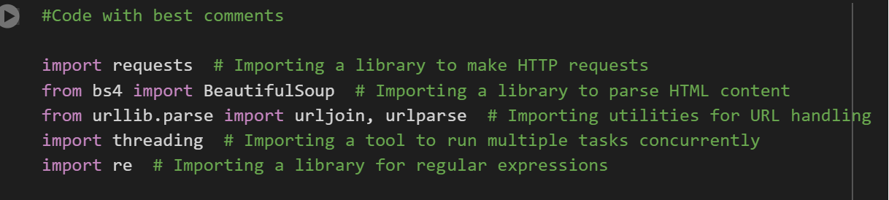
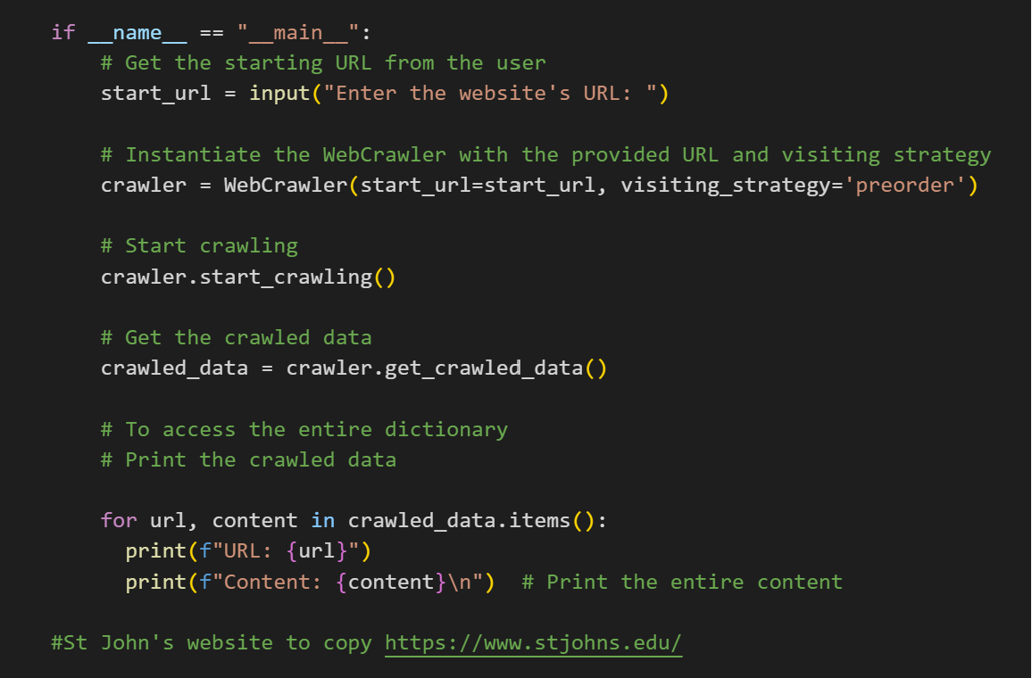
Key Features of our AIWebCrawler
Requirements to Web Crawler
Version 1
Chat GPT, Gemini
Libraries
Requests
BeautifulSoup
UrlLib
Threading
re
WebCrawler Class
Methods
Data Storage
Key-Value Dictionary
Notes:
Systematic Exploration and Data Extraction: The web crawler is designed for systematic navigation through web pages, focusing on extracting valuable information from diverse sources, particularly from St. John's University's website. This ensures a comprehensive gathering of data across different sections of the site.
Use of Python and Selenium: The crawler leverages Python for its core programming, known for its readability and extensive library support, and Selenium for automating web browser interaction. This combination enhances the crawler's capability to interact with dynamic web content effectively.
URL Frontier and Navigation: The crawler utilizes a queue data structure for managing URLs, adopting a first-in-first-out (FIFO) approach. This supports the 'preorder' visiting strategy, facilitating an orderly and efficient exploration of web pages.
HTML Fetching and Parsing: Utilizing the Requests library for fetching web content and BeautifulSoup for parsing HTML, the crawler efficiently downloads and extracts text, links, and metadata from pages. These tools are pivotal for accessing and processing web content.
Data Storage: Extracted data is stored in a structured manner using an SQLite database, which is suitable for handling small to medium-sized datasets. This ensures organized storage and retrieval of collected data.
Politeness and Duplication Handling: The crawler respects robots.txt files and incorporates strategic delays between requests to prevent server overload. It also employs a hash-based strategy for avoiding duplicate URLs, ensuring efficient and ethical crawling practices.
Scalability and Error Handling: The design includes a distributed architecture with threading for parallel processing, allowing for scalability and enhanced speed. Comprehensive error handling techniques, including retries and error logging, are implemented to manage network challenges and invalid URLs effectively.
AI Integration: The project heavily integrates AI, specifically leveraging ChatGPT for code generation and optimization. This approach facilitated the development process, from initial code generation to subsequent modifications for enhancing crawler performance.
Optimization Techniques: The crawler incorporates asynchronous requests and multithreading to improve runtime and efficiency, enabling it to visit multiple pages simultaneously and reduce the overall data collection time.
Insights into AI's Impact on Development: The use of AI, particularly for code optimization and problem-solving, provided significant insights into AI capabilities, improving the team's understanding of web crawling concepts and programming practices.

Slide 6
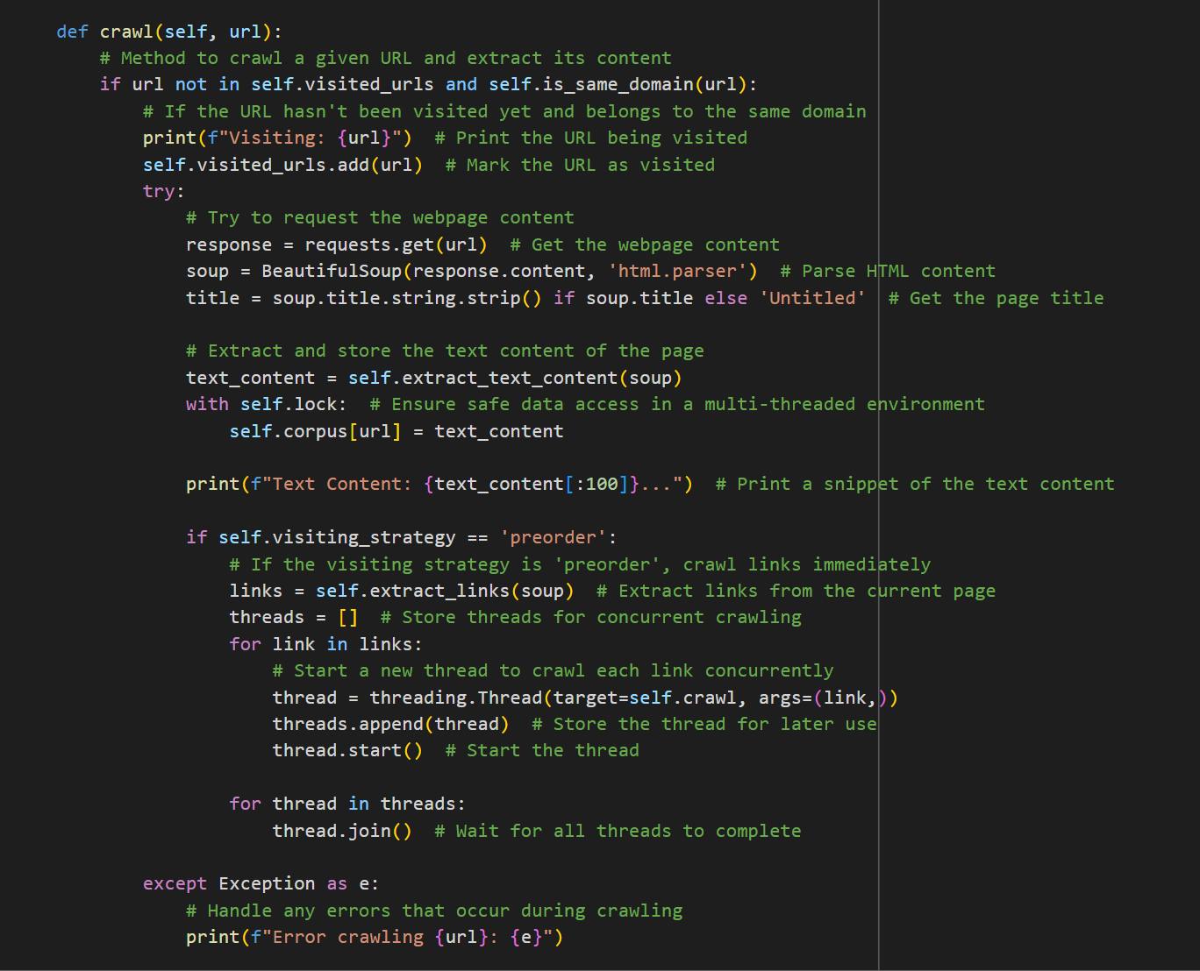
Key Features of our AIWebCrawler
5. HTML Fetching and Parsing
BeautifulSoup for parsing HTML
6. Politeness and Duplication Handling
Web-Crawler respects robots.txt files and incorporates strategic delays between requests to prevent server overload
7. Scalability and Error Handling
8. AI Integration
Leveraging ChatGPT for code generation and optimization
9. Optimization Techniques
Incorporates asynchronous requests and multithreading to improve runtime and efficiency, enabling it to visit multiple pages simultaneously
10. Insights into AI's Impact on Development
AI, particularly for code optimization and problem-solving, provided significant insights into AI capabilities, improving the team's understanding of web crawling concepts and programming practices
Notes:
Systematic Exploration and Data Extraction: The web crawler is designed for systematic navigation through web pages, focusing on extracting valuable information from diverse sources, particularly from St. John's University's website. This ensures a comprehensive gathering of data across different sections of the site.
Use of Python and Selenium: The crawler leverages Python for its core programming, known for its readability and extensive library support, and Selenium for automating web browser interaction. This combination enhances the crawler's capability to interact with dynamic web content effectively.
URL Frontier and Navigation: The crawler utilizes a queue data structure for managing URLs, adopting a first-in-first-out (FIFO) approach. This supports the 'preorder' visiting strategy, facilitating an orderly and efficient exploration of web pages.
HTML Fetching and Parsing: Utilizing the Requests library for fetching web content and BeautifulSoup for parsing HTML, the crawler efficiently downloads and extracts text, links, and metadata from pages. These tools are pivotal for accessing and processing web content.
Data Storage: Extracted data is stored in a structured manner using an SQLite database, which is suitable for handling small to medium-sized datasets. This ensures organized storage and retrieval of collected data.
Politeness and Duplication Handling: The crawler respects robots.txt files and incorporates strategic delays between requests to prevent server overload. It also employs a hash-based strategy for avoiding duplicate URLs, ensuring efficient and ethical crawling practices.
Scalability and Error Handling: The design includes a distributed architecture with threading for parallel processing, allowing for scalability and enhanced speed. Comprehensive error handling techniques, including retries and error logging, are implemented to manage network challenges and invalid URLs effectively.
AI Integration: The project heavily integrates AI, specifically leveraging ChatGPT for code generation and optimization. This approach facilitated the development process, from initial code generation to subsequent modifications for enhancing crawler performance.
Optimization Techniques: The crawler incorporates asynchronous requests and multithreading to improve runtime and efficiency, enabling it to visit multiple pages simultaneously and reduce the overall data collection time.
Insights into AI's Impact on Development: The use of AI, particularly for code optimization and problem-solving, provided significant insights into AI capabilities, improving the team's understanding of web crawling concepts and programming practices.

Slide 7


AI Integration
Used multithreading techniques to analyze numerous web pages at once, resulting in a boost in crawling performance.
Scaling down errors, ensuring code runs smoothly with reduced runtime
Enhanced web crawler capabilities using integrated AI (Chat GPT), resulting in more effective data extraction
Used ChatGPT to understand new terminologies related to web crawlers
Asked ChatGPT to come up with its own code for comparison and analysis
7
Notes:
Code Generation: At the outset, the team established the requirements for the web crawler and consulted ChatGPT to generate the initial Python and Selenium codes needed for the project. This step was fundamental, as it provided a starting point for the development process, enabling the team to have a tangible codebase to test and further develop.
Code Optimization: Throughout the development process, the team faced challenges related to the web crawler's performance, such as its runtime efficiency. To address these issues, AI was consulted for optimization strategies. For instance, when confronted with the problem of extended runtime, the team sought the assistance of ChatGPT to explore alternative solutions. This led to the recommendation and integration of multithreading techniques, significantly reducing the code's execution time by enabling the crawler to visit multiple pages simultaneously.
Troubleshooting and Enhancements: AI's role extended beyond initial code generation to include troubleshooting and enhancing the web crawler's functionality. When specific challenges arose, such as navigating the complexities of HTML content extraction or adhering to politeness policies to prevent the crawler from being banned or blocked by websites, the team turned to ChatGPT for solutions. AI provided guidance on using libraries like BeautifulSoup in conjunction with regular expressions for more accurate data extraction and offered strategies for implementing polite crawling practices.
Learning and Skill Development: The integration of AI into the project facilitated a deeper understanding of various programming concepts and techniques among the team members. By interacting with ChatGPT, the team members were exposed to new ideas and best practices in web crawler development, from parsing HTML content to optimizing database queries. This exposure not only helped in solving immediate project challenges but also contributed to the team's overall programming skill enhancement.
Iterative Development Process: The project adopted an iterative development process, where AI played a recurring role in generating, testing, and refining the web crawler's code. This process allowed for continuous learning and adaptation, with AI providing instant feedback and suggestions for improvement based on the team's queries and the challenges encountered.
Comparative Analysis: Lastly, AI facilitated a comparative analysis of different web crawler codes. The team used ChatGPT to generate a completely new web crawler code, which they then ran alongside the existing one to identify differences and determine the best-performing solution. This innovative approach, enabled by AI, highlighted the practical benefits of AI integration in evaluating and selecting the most effective coding strategies.

Slide 8
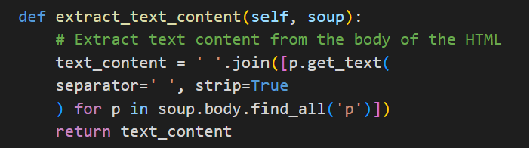
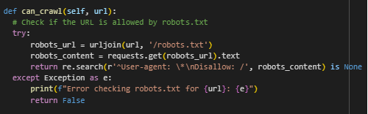
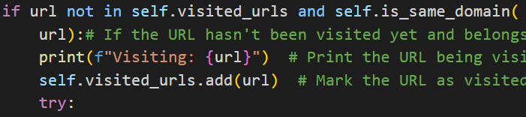
Challenges
Extracting Relevant Content
2. Runtime Efficiency of the Web Crawler
3. Adhering to Website's Policies and Procedures
Hours of runtime
Infinite Loops
Solution
Multithreading
Set of URL's
Ignored links with "Resource"
Getting banned or blocked from website
Politeness
Robots.txt
Solution
Snippet of Code to respect Robots.txt
Crawl Delay
Version 1 ---> Final Version
Handling PDF
Outputs
Solution
Regular Expressions

Slide 9
Summary
Purpose: Design a web crawler to systematically explore and extract information from St. John's University's website.
Design:
Prioritizes depth-first exploration ("preorder").
Employs politeness strategies (respecting robots.txt, delays between requests).
Handles duplicate URLs to prevent infinite loops.
Uses tools like BeautifulSoup for HTML parsing and handling dynamic content.
Designed for potential scaling and error handling.
Saves content in a dictionary that was saved in a text file.
Implementation:
Python was the chosen language with libraries 'requests' and 'BeautifulSoup' being key.
Thorough testing and optimization techniques were used.
Challenges:
Complex HTML structures and varying encoding.
Adhering to website politeness policies.
Lengthy code runtime.
AI Integration:
ChatGPT (and similar AI tools) were used to generate code, optimize efficiency, and provide explanations of web crawling concepts.
Conclusion: The project successfully implemented a web crawler while highlighting the importance of careful design. AI proved to be a valuable tool in enhancing the development process and improving the team's programming skills.
Notes:
Systematic Exploration and Data Extraction: The web crawler is designed for systematic navigation through web pages, focusing on extracting valuable information from diverse sources, particularly from St. John's University's website. This ensures a comprehensive gathering of data across different sections of the site.
Use of Python and Selenium: The crawler leverages Python for its core programming, known for its readability and extensive library support, and Selenium for automating web browser interaction. This combination enhances the crawler's capability to interact with dynamic web content effectively.
URL Frontier and Navigation: The crawler utilizes a queue data structure for managing URLs, adopting a first-in-first-out (FIFO) approach. This supports the 'preorder' visiting strategy, facilitating an orderly and efficient exploration of web pages.
HTML Fetching and Parsing: Utilizing the Requests library for fetching web content and BeautifulSoup for parsing HTML, the crawler efficiently downloads and extracts text, links, and metadata from pages. These tools are pivotal for accessing and processing web content.
Data Storage: Extracted data is stored in a structured manner using an SQLite database, which is suitable for handling small to medium-sized datasets. This ensures organized storage and retrieval of collected data.
Politeness and Duplication Handling: The crawler respects robots.txt files and incorporates strategic delays between requests to prevent server overload. It also employs a hash-based strategy for avoiding duplicate URLs, ensuring efficient and ethical crawling practices.
Scalability and Error Handling: The design includes a distributed architecture with threading for parallel processing, allowing for scalability and enhanced speed. Comprehensive error handling techniques, including retries and error logging, are implemented to manage network challenges and invalid URLs effectively.
AI Integration: The project heavily integrates AI, specifically leveraging ChatGPT for code generation and optimization. This approach facilitated the development process, from initial code generation to subsequent modifications for enhancing crawler performance.
Optimization Techniques: The crawler incorporates asynchronous requests and multithreading to improve runtime and efficiency, enabling it to visit multiple pages simultaneously and reduce the overall data collection time.
Insights into AI's Impact on Development: The use of AI, particularly for code optimization and problem-solving, provided significant insights into AI capabilities, improving the team's understanding of web crawling concepts and programming practices.

Slide 10






Thanks All!
Jomo Smith (He/Him)
​
Rosa DiLiberto (She/Her)
Omar Shajib (He/Him)
Elena Ajayi (She/Her)
Jordan Hayes (He/Him)
Joshua Souane (He/Him)

